Slide 1
Phaser Indie Project – Prototype
by Gordon

Slide 2
Phaser Indie Project – Prototype
Game Idea
Game Concept
Example

Slide 3
Game Idea
Puzzle game.
A simple story of a Hero rescuing his princess.
2D game that rendered in 3D style.
Turn based strategy Game between Player and CPU.
The Idea is inspired by “Lara Croft Go”.

Slide 4
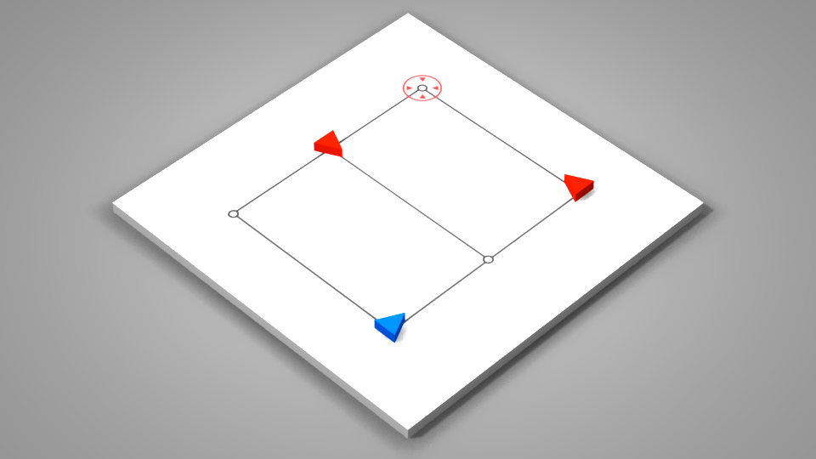
Game Concept
Player (blue triangle) is trying to reach his destination (red circle).
Enemy (red triangle) is guarding the rout to prevent Player reach the destination.
Player can move to one spot in each turn. Enemy can only move if he is in range (facing) to attack Player. Player can attach the Enemy from his both sides or back.

Slide 5
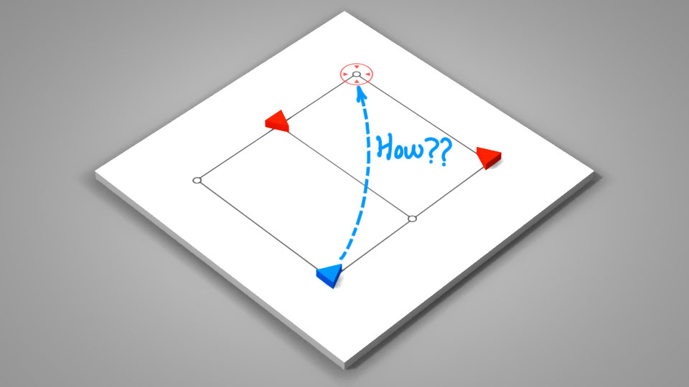
Example
How to reach the destination?

Slide 6
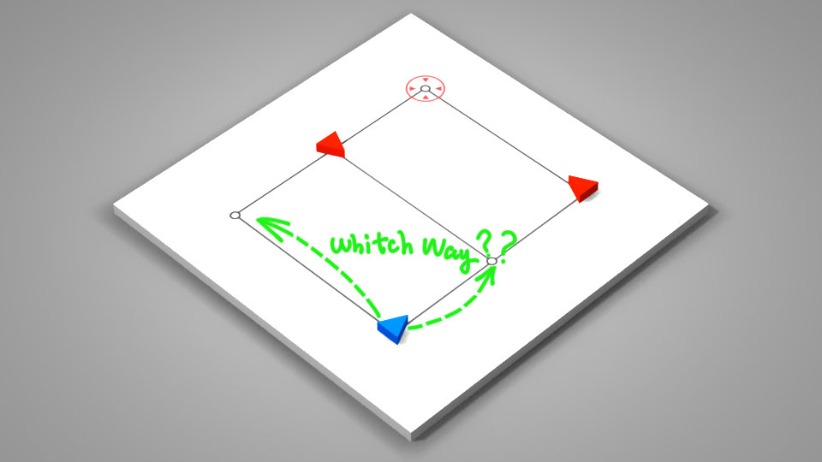
Example
Which way should Player move to?

Slide 7
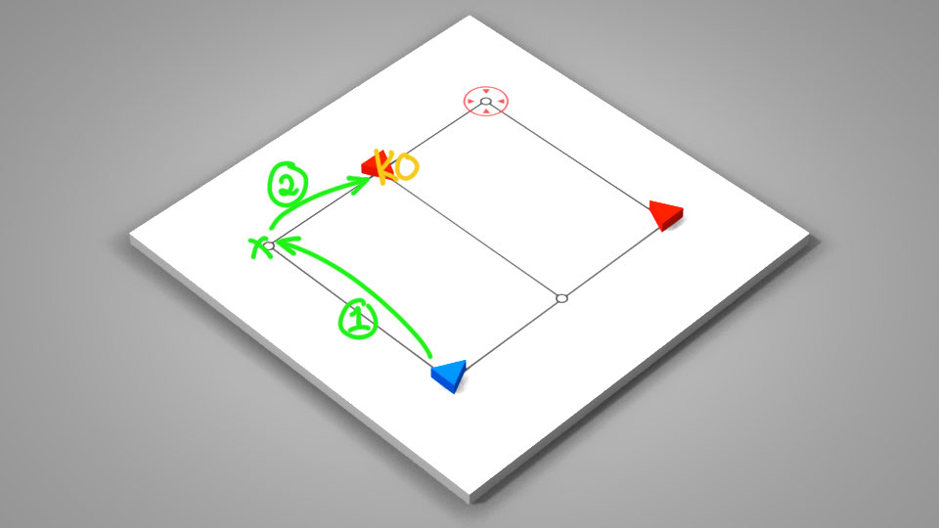
Example
Player can attach one of the Enemies in two steps.

Slide 8
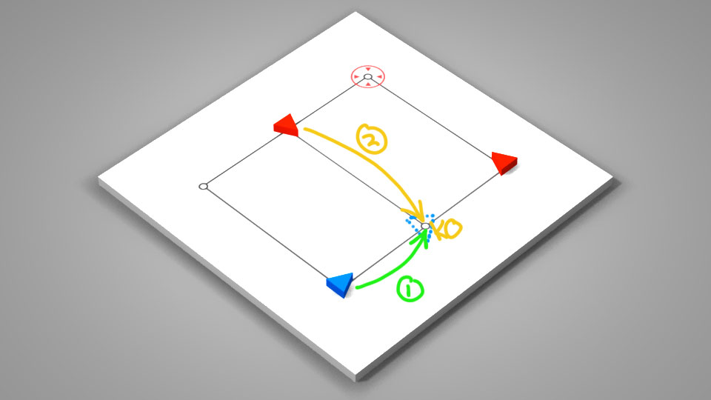
Example
If Player moves this way. He is in front of one of Enemies and will be killed by this Enemy.

Slide 9
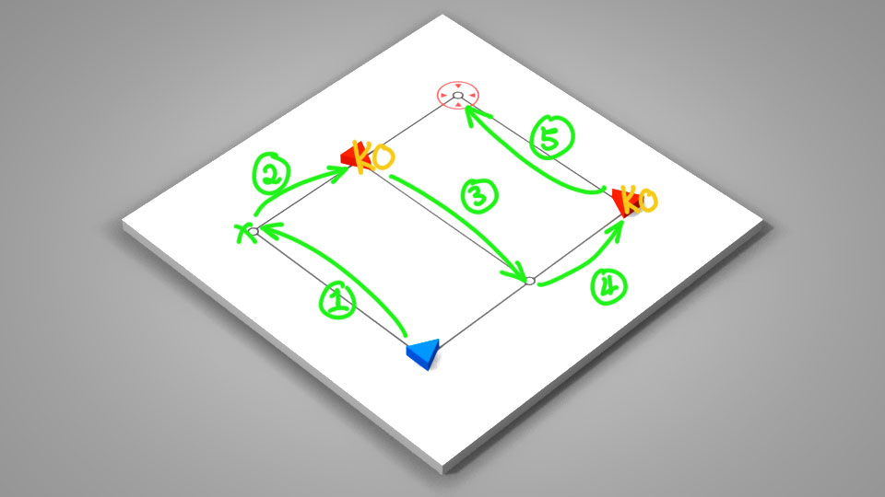
Example
The appropriate Player movement is shown in this Figure.

Slide 10
Thanks for viewing

